Slide 1
Death Star
RFID Reader
Robinson Merillat
Robert Schreibman

Slide 2
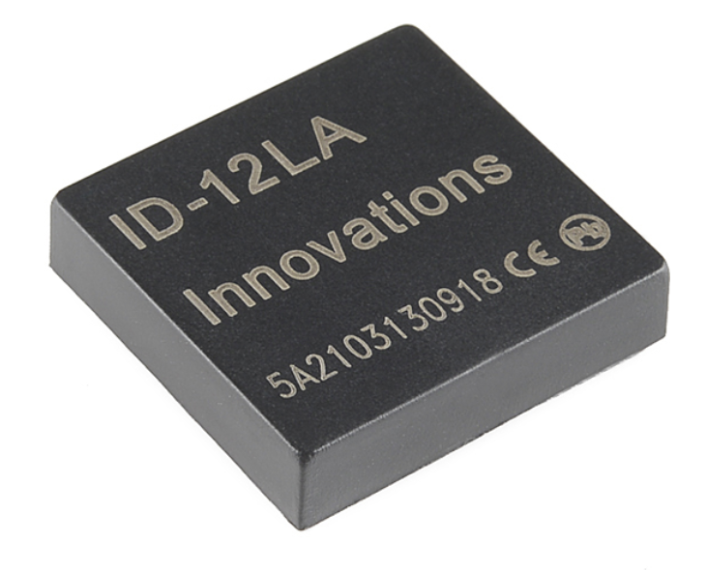
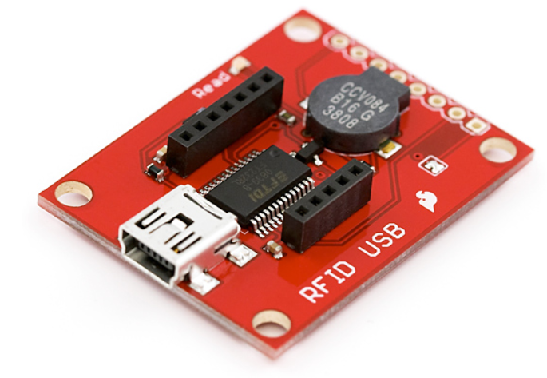
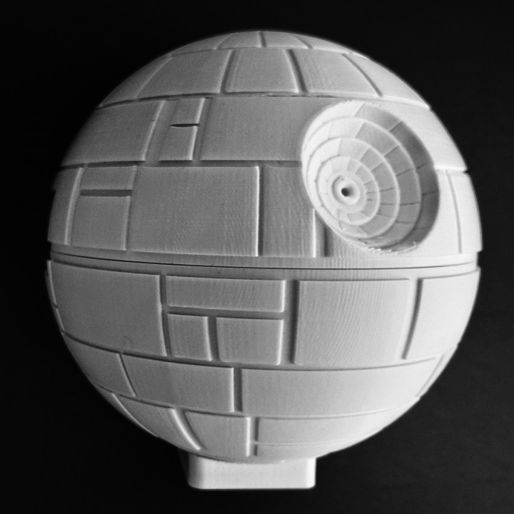
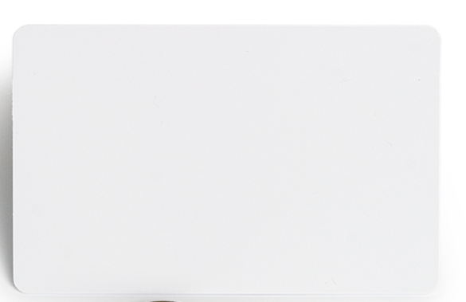
Materials Used
1 x RFID USB Reader
1 x ID-12LA RFID Module
2 x RFID Card - 125kHz
1 x Death Star 3D Print
https://www.sparkfun.com/products/13198
https://www.myminifactory.com/object/3d-print-starwars-deathstar-raspberry-pi-3-case-50612

Slide 3
What we have done
RFID Reader will store RFID tags and maintain a history of previous users
New users will scan in and can make a profile with their information (name, password, etc)

Slide 4
What we will implement this weekend
Menu
Login using username & password
Create Account
Options to play a variety of games
Update information
username
password
Game Data
Each game will store user stats into a dictionary that is matched up with each RFID tag.

